Slide 1

Digital portfolio :
Name:M. Samreena
Register no:24134131802522017
Department: Bsc cs
college: Deen college of arts and science
NmId:
asanm41341324214017/
BBE2FB37BB3D974B49F4DFA05C79F281

Slide 2
student digital portfolio

Slide 3

Agenda:
problem statement
project overview
end users
tools and technologies
portfolio design and layout
features and functionality
results and screenshot
conclusion
github link

Slide 4
problem statement:
Individuals often lack a professional online presence to effectively showcase their skills, projects, and achievements. This project solves the problem by developing a responsive portfolio website for Samreena using HTML, CSS, and JavaScript, enabling her to present her work attractively and connect easily with potential recruiters or clients.

Slide 5

Project overview:
The Samreena Portfolio Website is a responsive personal portfolio built with HTML, CSS, and JavaScript. It showcases skills, projects, and contact details through a modern blue-themed design with calligraphy headings. The site includes sections for About, Projects, Skills, and Contact, featuring a responsive layout, interactive form, and elegant styling to create a strong professional online presence.

Slide 6
end users :
The end users of this portfolio website are recruiters, hiring managers, clients, and general visitors who want to learn about Samreena’s skills, projects, and contact details in a professional and interactive way.

Slide 7

tools and technologies:
HTML5 – Structure of the website
CSS3 – Styling & layout (colors, typography, responsiveness)
JavaScript (ES6) – Interactivity & form handling
Google Fonts – Custom typography (Great Vibes, Inter)
VS Code – Code editor (development)
Browser (Chrome/Edge/Firefox) – Testing & preview

Slide 8
Portfolio design and layout:
The portfolio follows a clean, modern, and responsive design with a blue color theme and calligraphy headings.
Navigation bar – sticky, with smooth links.
Hero section – intro with name, tagline, and call-to-action buttons.
About section – short bio in elegant typography.
Projects section – grid layout with project cards.
Skills section – chip-style highlights.
Contact form – simple, user-friendly design.
Footer – minimal with auto-updating year.

Slide 9

Features and functionality:
Responsive design – works on desktop & mobile.
Sticky navigation bar with smooth scrolling.
Hero section – intro, name, and call-to-action buttons.
About section – short personal introduction.
Projects showcase – grid layout with project cards.
Skills section – chip-style highlights of core skills.
Contact form – simple message submission with live status.
Auto-updating footer year via JavaScript.

Slide 10
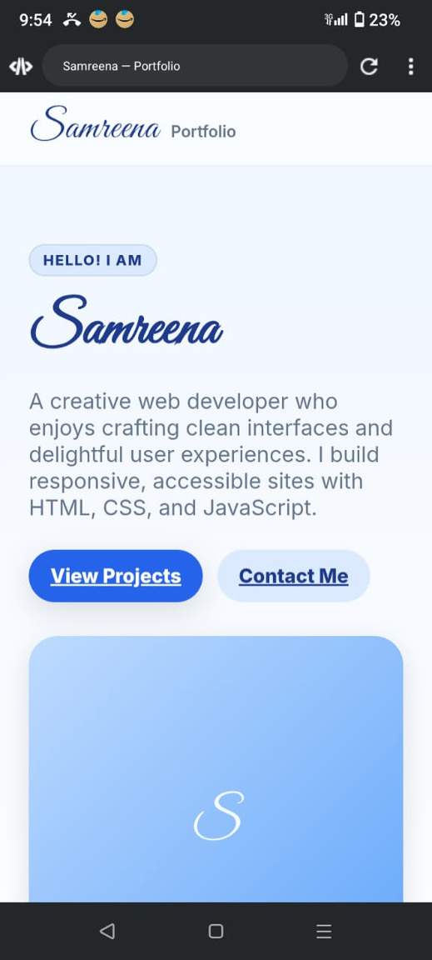
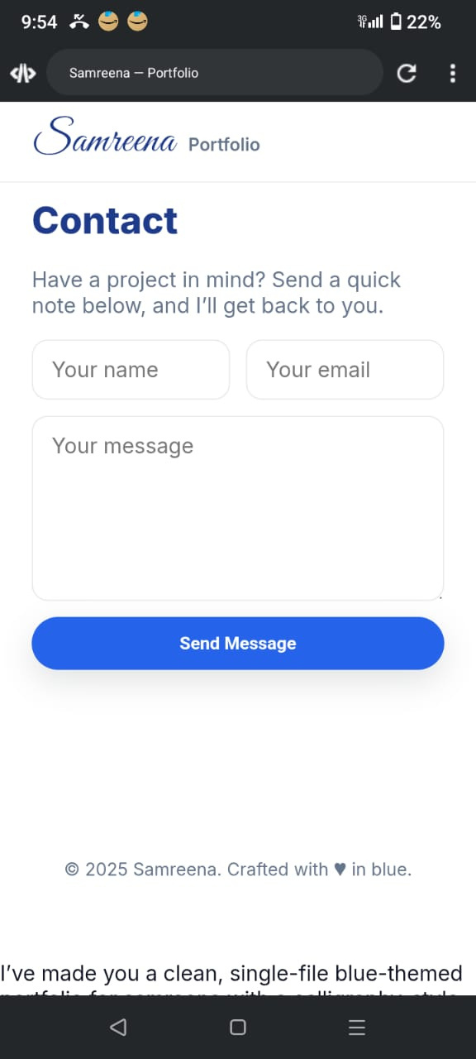
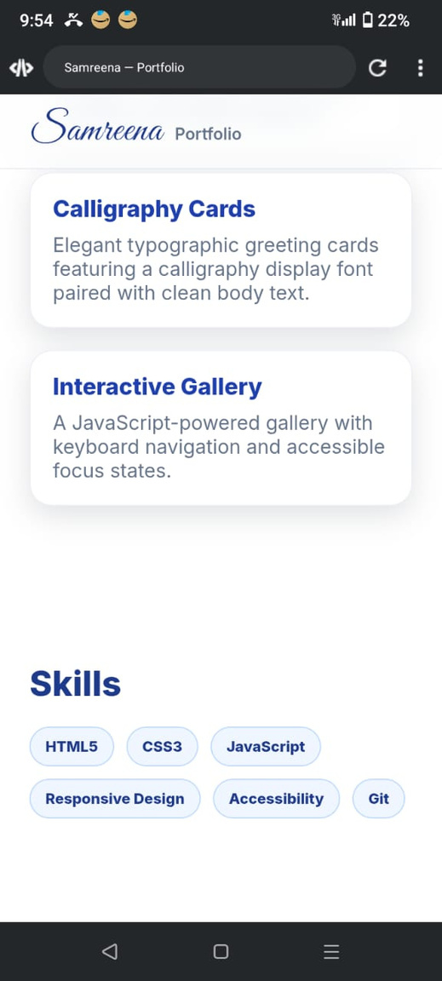
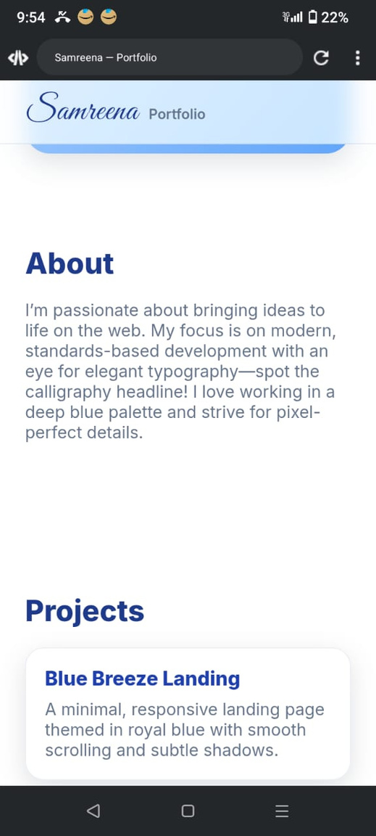
Results and screenshot:

Slide 11
Conclusion:
The Samreena Portfolio Website successfully showcases skills, projects, and contact details through a modern, responsive, and user-friendly design. Built with HTML, CSS, and JavaScript, it provides a professional online presence while ensuring accessibility and interactivity.

Slide 12
github link :
https://github.com/dccs24samreena-spec/Samreena-TNSDC-FWD-DP.git

